Slide 1
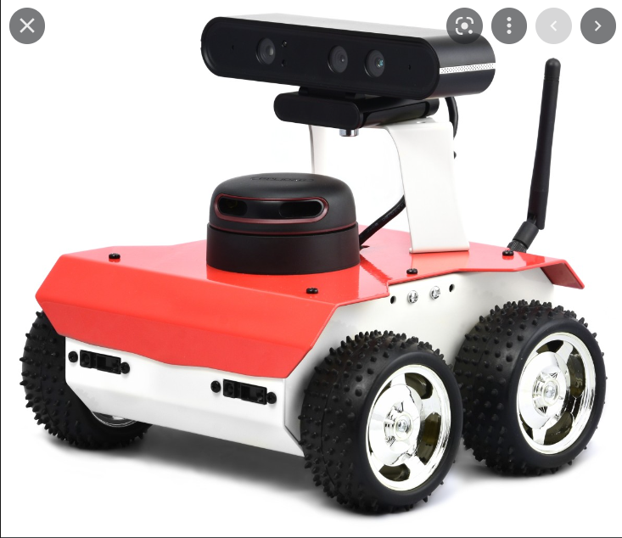

Slide 3
But what happens when:

Slide 5
Is that real robot autonomy?

Slide 6
We need a Behaviour Planner!
Finite State Machine
Define a State and a transition condition between each state
-> Complicated really quick and not easy to extend
Behaviour Trees
Hierarchical Structure of Sequences, Fallbacks and Conditions
Easy to create and extend, more flexibility

Slide 7
Research Question
How can we improve the behaviour planning for a robot in order to achieve better safety and reliability?
-> Solving this decreases the need for human intervention while the robot is running
-> Create a behaviour planning approach which tackles as many scenarios as possible when a human is needed

Slide 8
Meaning of safety in this context?
The robot should not harm anyone or anything else including itself.
-> Avoid crashes, even when all sensors fail
-> Detect sensor crashes
-> Find ways to move while the sensor is being restarted or come to a safe stop if that‘s not possible

